Slide 1
Effect of various factors on motor vehicle accident fatality rates
By: Stefan Maciolek

Slide 2
Introduction – objectives of the study
To identify factors that are significant in predicting if an accident will be fatal
Not able to analyze what causes accidents in the first place

Slide 3
Introduction – sampling of previous findings
A study by Doherty et Al. found that accident rates were higher at night, on weekends, and for teenagers only, when passengers were present
Zhou and Sisiopiku found a parabolic relationship between traffic volume and max road capacity, high traffic accidents less likely to be fatal than low traffic accidents
Evans et. Al found that car size was not important in predicting accident survivability, only car mass
Thompson et. Al explored using mobile phones to identify and avoid adverse conditions – cell phone use may become increasingly correlated with accident survivablity in the future
See references for more details

Slide 4
Methods - Variables included in the Analysis
~7400 observations of accidents in Vermont in 2016
Outcome (dependent, 0, 1, or 2)
Weather Severity (0-4)
Time of Day (1-4)
Day of the week (1-7)
Impairment (0-2)
Surface Condition (0-3)

Slide 5
Methods - Univariate
Histograms produced for each variable
Transformations not possible for these data
Qq-plots, box plots, dot plots, etc. not useful for these data

Slide 6
Methods - Bivariate
“Sliced” histograms produced showing histogram of outcome for each level of the predictor
Scatter plots not suited for these data
Chi-Square test to prove relationship between predictor and outcome
Directionality inferred from sliced histograms

Slide 7
Methods - Multivariate
Analysis 1 – Logistic regression fit, including every combination of predictor interactions
Response recoded to (0,1)
Stepwise and backwards model selection both employed
Confidence interval for Odds Ratio constructed
Analysis 2 - Factor analysis – PCA, rotation, discard unimportant factors
Cluster analysis and find mean outcome per cluster
ANOVA with contrast to prove cluster means are different
Identify which cluster has the highest mean
Compare high cluster means with entire dataset mean via t-test

Slide 8
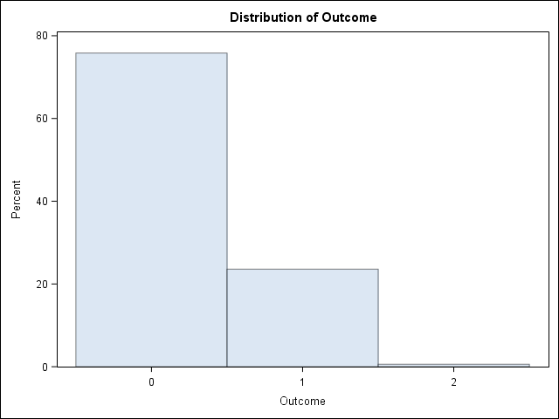
Univariate Results - Outcome

Slide 9
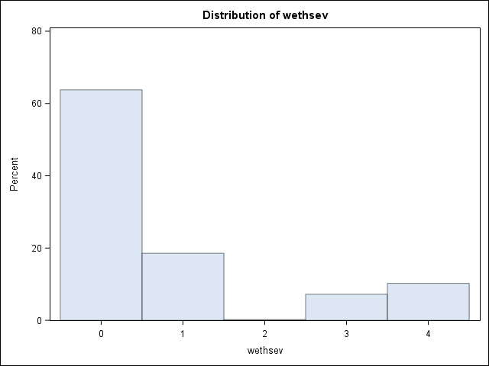
Univariate Results - Weather Severity

Slide 10
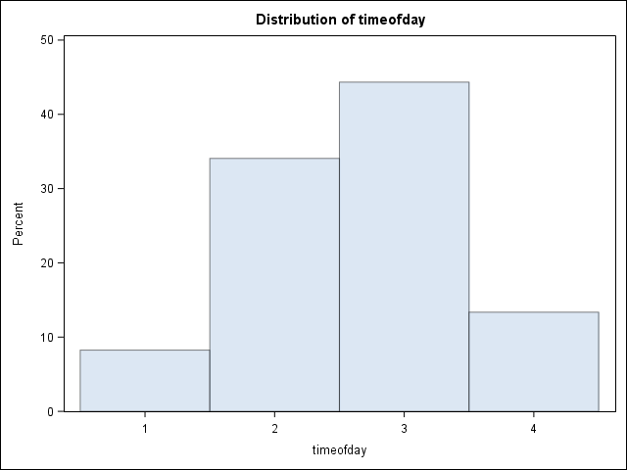
Univariate Results - Time of Day

Slide 11
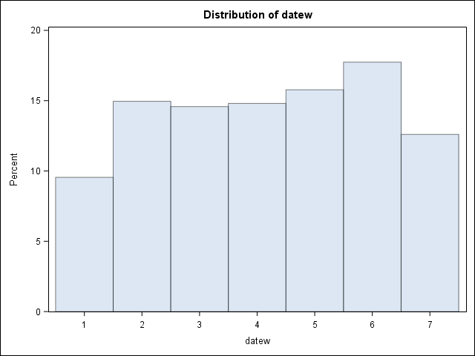
Univariate Results - Day of the Week

Slide 12
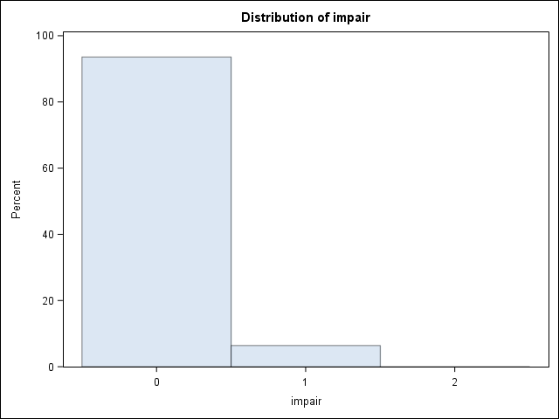
Univariate Results - Impairment

Slide 13
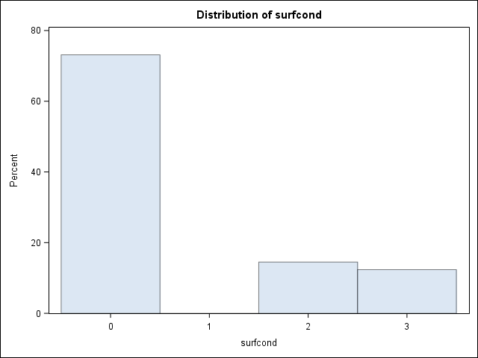
Univariate Results - Road Surface Condition

Slide 14
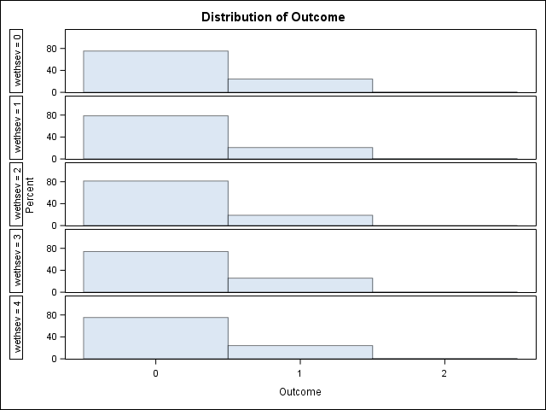
Bivariate - Outcome vs Weather Severity

Slide 15
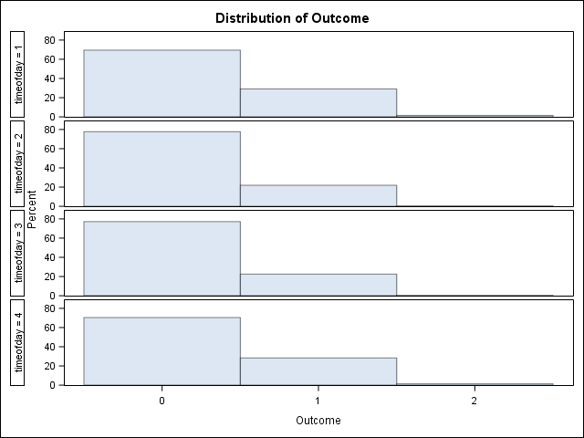
Bivariate Results - Outcome vs Time of Day

Slide 16
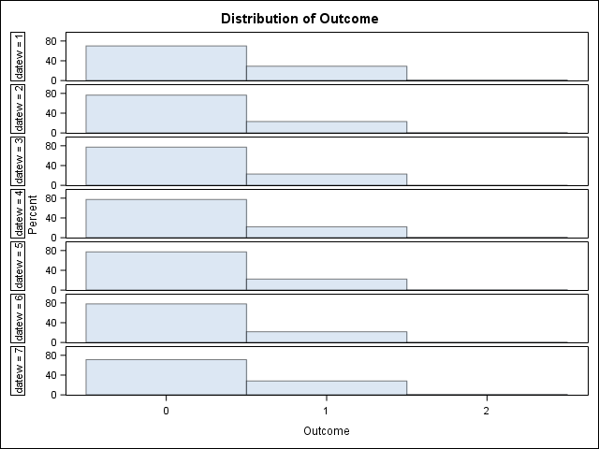
Bivariate Results - Outcome vs Day of the Week

Slide 17
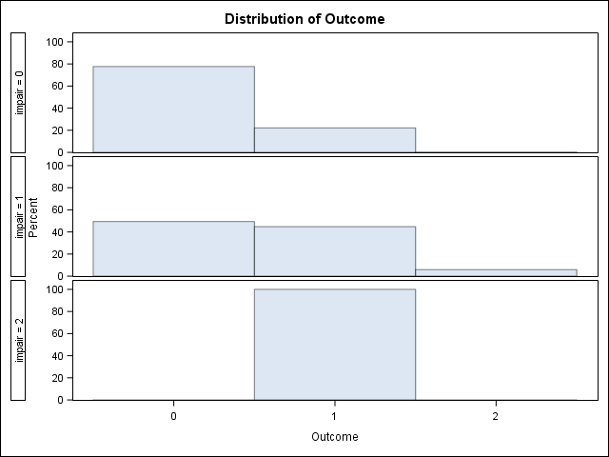
Bivariate Results - Outcome vs Impairment

Slide 18
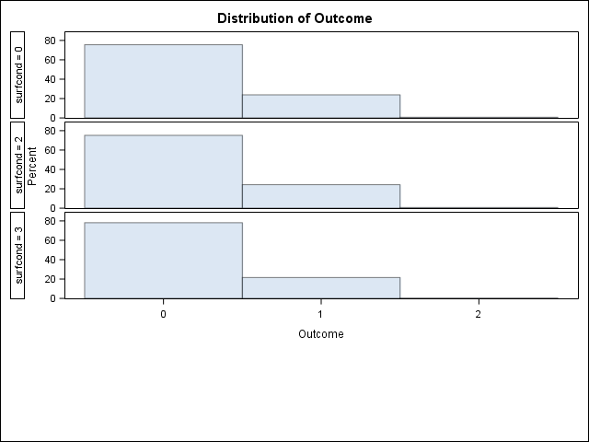
Bivariate Results - Outcome vs Road Surface Condition

Slide 19

Bivariate Hypothesis 1
Impairment causes accidents to result in injuries or fatalities more often
Chi-Square Test: $Χ^{2}$ = 380.8155, p < .0001
Significant difference, infer directionality from bivariate distribution

Slide 20

Bivariate Hypothesis 2
Accidents that occur late at night are more likely to result in injury or death
Chi-Square Test: $Χ^{2}$ = 51.0723, p < .0001
Significant difference, infer directionality from bivariate distribution

Slide 21

Bivariate Hypothesis 3
Accidents that occur on the weekend are more likely to result in injury or death
Chi-Square Test: $Χ^{2}$ = 38.4154, p = .0001
Significant difference, infer directionality from bivariate distribution

Slide 22
Multivariate Results – Logistic Regression
Only impairment was found to be significant, p < .0001
Odds ratio 95% Confidence interval: (.232,.338)
Odds ratio point estimate: .28

Slide 23
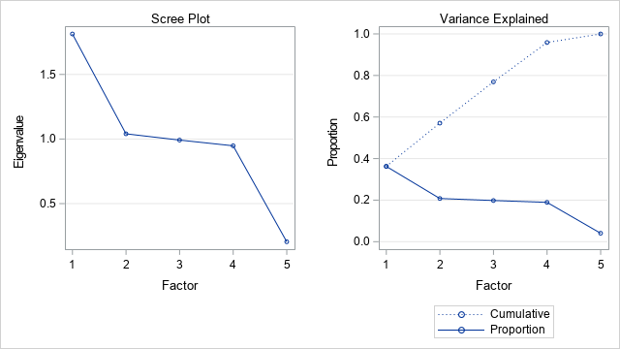
Multivariate Results - Factor Analysis
Rotated Factor Pattern
 | Factor1 | Factor2 | Factor3 | Factor4 | Factor5
wethsev | 0.95349 | -0.02942 | -0.01793 | -0.00485 | -0.2994
timeofday | -0.04493 | 0.99869 | 0.00756 | 0.02295 | -0.00245
datew | -0.01678 | 0.00753 | 0.99981 | 0.00635 | 0.00048
impair | -0.0069 | 0.02287 | 0.00635 | 0.99969 | -0.00035
surfcond | 0.93887 | -0.04547 | -0.00982 | -0.00692 | 0.34105

Slide 24
Multivariate Results - Cluster Analysis
Cluster | N | Outcome Mean | Outcome Std Dev
1 | 1708 | 0.2265808 | 0.4187417
2 | 1501 | 0.2178548 | 0.4129257
3 | 2008 | 0.2241036 | 0.4170945
4 | 1742 | 0.2256028 | 0.4180987
5 | 477 | 0.5073375 | 0.500471

Slide 25
Multivariate Results - ANOVA
Source | DF | Sum of Squares | Mean Square | F Value | Pr > F
Model | 4 | 35.975322 | 8.993831 | 50.33 | <.0001
Error | 7431 | 1327.790546 | 0.178683
Corrected Total | 7435 | 1363.765869
Contrast | 1 | 35.93015854 | 35.93015854 | 201.08 | <.0001

Slide 26
Multivariate Results - Comparison of cluster with total dataset
 | total mean | subset mean | 95% Confidence interval | t-value | p-value
Outcome: | 0.2419 | 0.5073 | (0.2193,0.3115) | 11.32 | <.0001
wethsev: | 0.8155 | 0.7547 | (-0.1802,0.0587) | -1 | 0.3181
timeofday: | 2.628 | 2.7757 | (0.0366,0.2587) | 2.61 | 0.0093
datew: | 4.1592 | 4.2474 | (-0.1115,0.2878) | 0.87 | 0.3862
impair: | 0.0643 | 1.0021 | (0.9309,0.9448) | 265.03 | <.0001
surfcond: | 0.661 | 0.5996 | (-0.1538,0.355) | -1.24 | 0.214

Slide 27
Discussion and Conclusions
Impairment was found to be significant via Chi-square test, logistic regression, and multivariate analysis
Time of the day was found to be significant via Chi-square test and multivariate analysis, but not logistic regression
Day of the week was found to be significant only through Chi-Square test

Slide 28
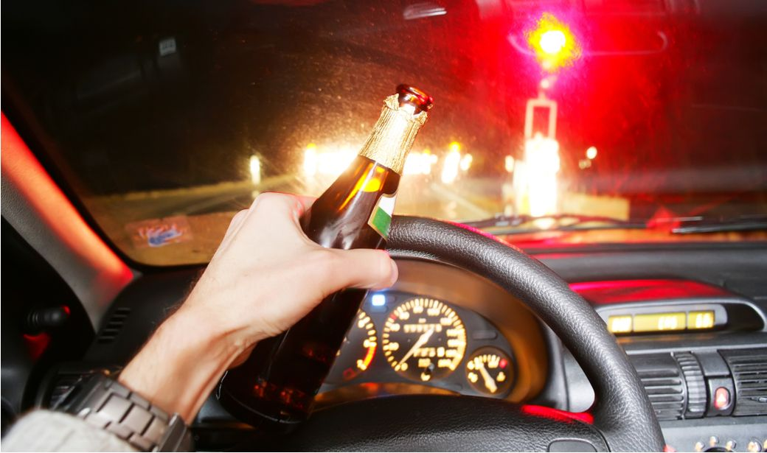
If you only take one thing away from this study……

Slide 29
References
Jove Graham, Jennifer Irving, Xiaoqin Tang, Stephen Sellers, Joshua Crisp, Daniel Horwitz, Lucija Muehlenbachs, Alan Krupnick, & David Carey (2015). Increased traffic accident rates associated with shale gas drilling in Pennsylvania. Accident Analysis and Prevention, 74, 203-209.
Matthew G. Karlaftis, Ioannis Golias (2002). Effects of road geometry and traffic volumes on rural roadway accident rates. Accident Analysis and Prevention, 34, 357-365.
Gudmundur F. Ulfarsson, Fred L. Mannering (2004). Differences in male and female injury severities in sport-utility vehicle, minivan, pickup and passenger car accidents. Accident Analysis and Prevention, 36, 135-147.
Panagiotis Ch. Anastasopoulos, Andrew P. Tarko, & Fred L. Mannering (2008). Tobit analysis of vehicle accident rates on interstate highways. Accident Analysis and Prevention, 40, 768-775.
Liacine Bouaoun, Mohamed Mouloud Haddak, & Emmanuelle Amoros (2015). Road crash fatality rates in France: A comparison of road user types, taking account of travel practices. Accident Analysis and Prevention, 75, 217-225.
Jessica B. Cicchino (2015). Why have fatality rates among older drivers declined? The relative contributions of changes in survivability and crash involvement. Accident Analysis and Prevention, 83, 67-73.
Sean T. Doherty, Jean C. Andrey, & Carolyn MacGregor (1998). The situational risks of young drivers: the influence of passengers, time of day, and day of week on accident rates. Accid. Anal. and Prev., 30(1), 45-52.
Md Tawfiq Sarwar, Panagiotis Ch. Anastasopoulos (2017). The effect of long term non-invasive pavement deterioration on accident injury-severity rates: A seemingly unrelated and multivariate equations approach. analytic Methods in Accident Research, 13, 1-15.
Leonard Evans, DPhil and Michael C. Frick (1992). Car Size or Car Mass: Which Has Greater Influence on Fatality Risk? American Journal of Public Health, 82, 1105-1112.
Chris Thompson, Jules White, Brian Dougherty, Adam Albright, and Douglas C. Schmidt (2010). Using Smartphones to Detect Car Accidents and Provide Situational Awareness to Emergency Responders. Lecture Notes of the Institute for Computer Sciences, 48, 29-42.
Min Zhou, Virginia P. Sisipiku (1997). Relationship between Volume-to-Capacity Ratios and Accident Rates. Transportation research records, 1581, 47-52.
Liling Li, Sharad Shrestha, & Gongzhu Hu (2017). IEEE computer society. 363-370
Almjewail A., Almjewail A., Alsenaydi S., ALSudairy H., Al-Turaiki I. (2018) Analysis of Traffic Accident in Riyadh Using Clustering Algorithms. In: Alenezi M., Qureshi B. (eds) 5th International Symposium on Data Mining Applications. Advances in Intelligent Systems and Computing, vol 753. Springer, Cham
Chen Chen (2017). Analysis and Forecast of Traffic Accident Big Data. ITM Web Conf. DOI: 10.1051/itmconf/20171204029
Ihm Sun-Young, Park Young-Ho. Brief Paper: Analysis of Traffic Accident using Association Rule Model. J Multimed Inf Syst 2018;5(2):111-114.
Da Tao, Rui Zhang, Xingda Qu (2017). The role of personality traits and driving experience in self-reported risky driving behaviors and accident risk among Chinese drivers. Accident Analysis and Prevention, 99, A, 228-235
Rudi De Raedt, Ingrid Ponjaert-Kristoffersen (2001). Predicting at-fault car accidents of older drivers. Accident Analysis and Prevention, 33, 809–819
Peter J.Cooper (1990). Differences in accident characteristics among elderly drivers and between elderly and middle-aged drivers. Accident Analysis & Prevention 22, 5, 499-508

